Slide 1
Assignment - I
Notes:
Was not able to get the percentage values in the complete note. Request support in the same.

Slide 2
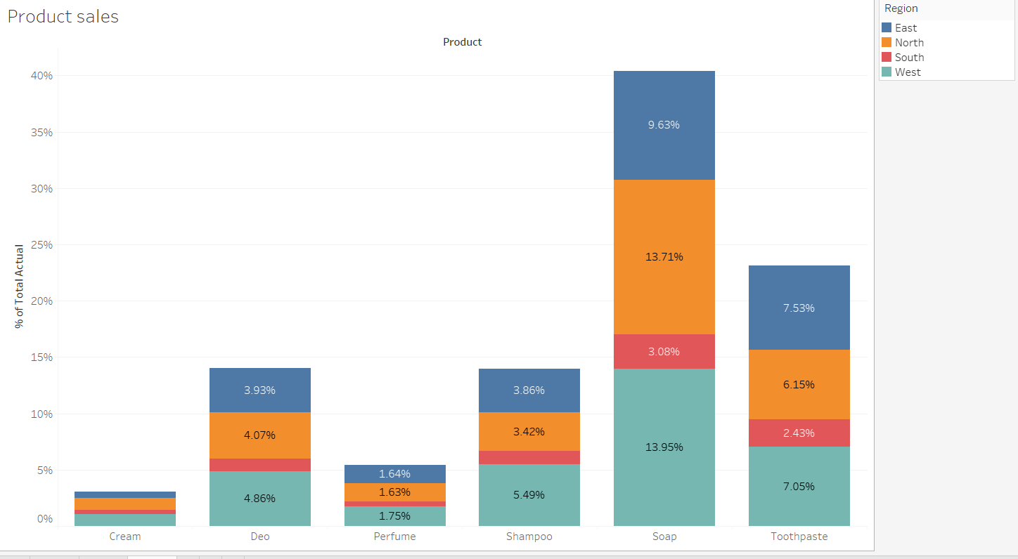
1. Show largest selling products and also show what % of sales is coming from which regions.
Notes:
Was not able to get the percentage values in the complete note. Request support in the same.

Slide 3
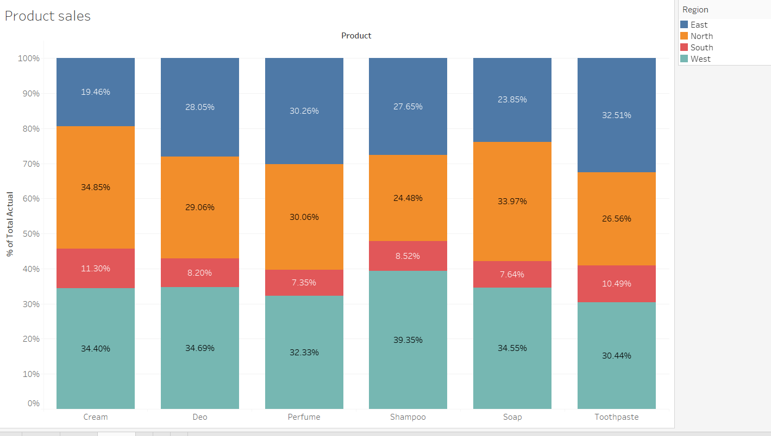
2. Convert the chart created in previous slide to 100% staked.
Notes:
Was not able to get the percentage values in the complete note. Request support in the same.

Slide 4
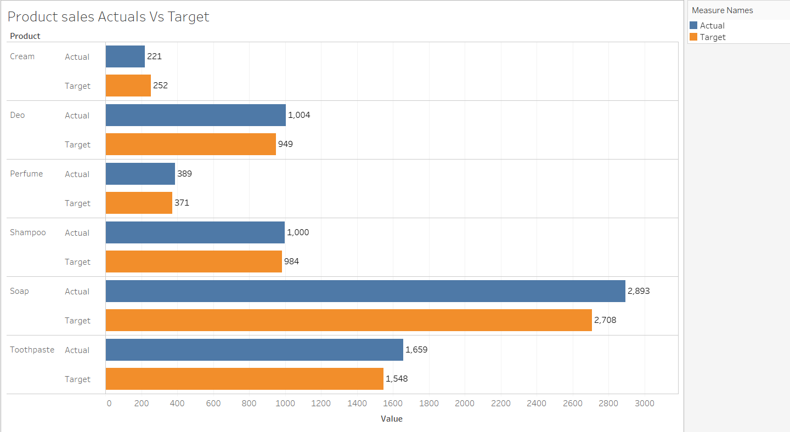
3. Create a side by side bar to compare Actual vs Target sales of different products
Notes:
Was not able to get the percentage values in the complete note. Request support in the same.

Slide 5
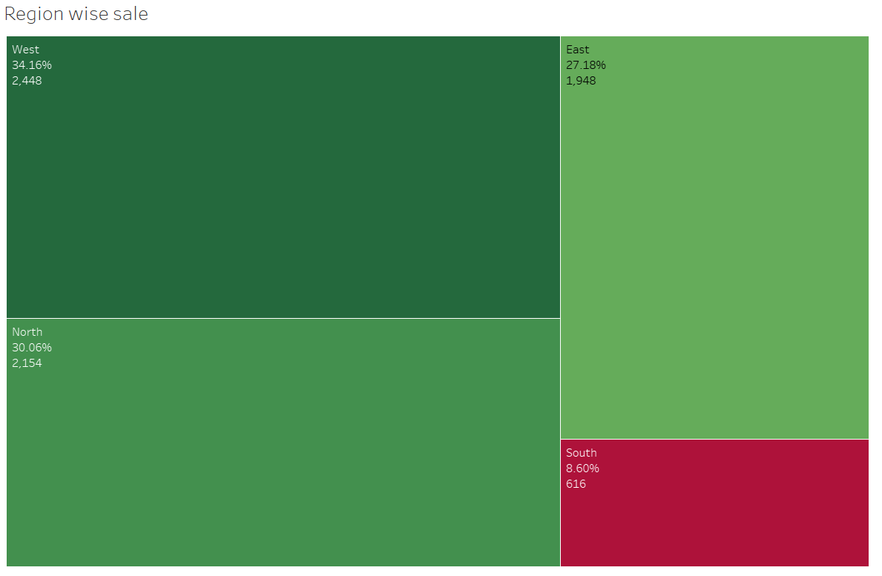
4.Create a tree map to show largest selling regions
Notes:
Was not able to get the percentage values in the complete note. Request support in the same.

Slide 6
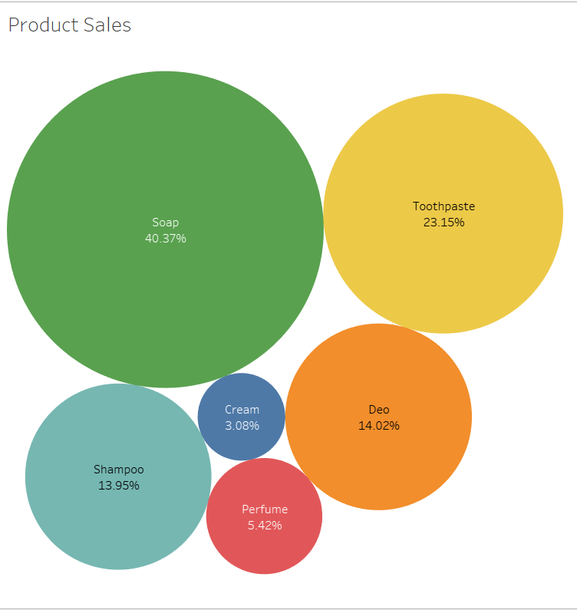
5. Create a packed bubble to show product sales
Notes:
Was not able to get the percentage values in the complete note. Request support in the same.

Slide 7
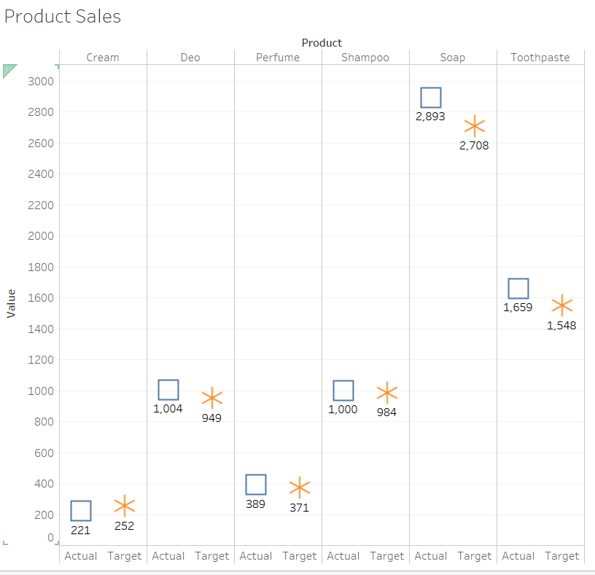
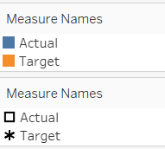
6. Create a side by side circle chart to compare actual vs target sales of different products
Notes:
Was not able to get the percentage values in the complete note. Request support in the same.

